Slide 1

Project Title : Plant Disease Predictor
Submitted By:
Anisha Srivastava(190110021)
Priyanshu Chauhan(190110022)
Surbhi Singh(190110023)
Ujjwal Tayal(190110024)
Group ID: IBM19-G17
Major : CSE-CCV
Submitted To :
Mr. Devendra Prasad Assistant Professor School of computing
Project Guide :
Ms. Meghavi Rana
Assistant Professor School of computing

Slide 2

Project Overview
Plant diseases and is one kind of natural disasters that affect the normal growth of plants and even cause plant death .
This project will not only help in predicting disease suffered by plant but it will also act as an interactive web application .In this way , prediction of plant disease will become faster as compared to basic laboratory methods.

Slide 3
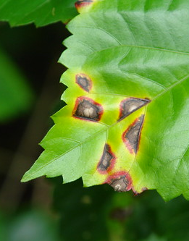
Project Objectives
The overall objective of this project is to write a program that will identify a plant diseases and give information about their cure .
In this project we will design a deep learning model using CNN technique for recognition of plant disease.

Slide 4
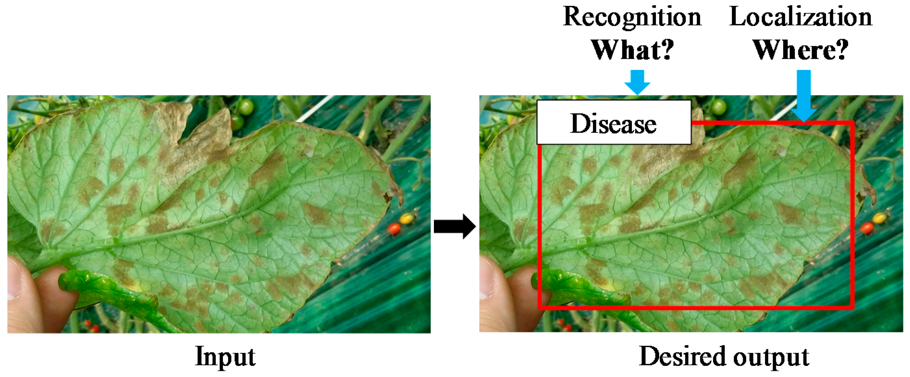

Slide 5
Implementation Details
Hardware Required:
Intel core i5 or more
RAM 8GB
Software/Libraries Required:
Flask
Visual Studio Code
Keras
TensorFlow

Slide 6
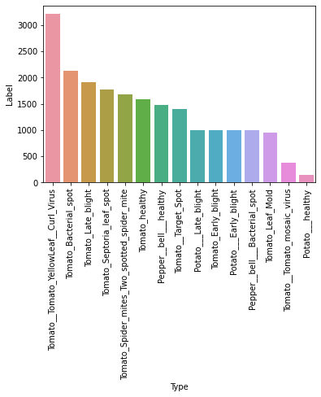
Dataset Description
Dataset used contains images of healthy as well as diseased plant leaves. There are around 42,ooo images, which are used for training model.

Slide 7
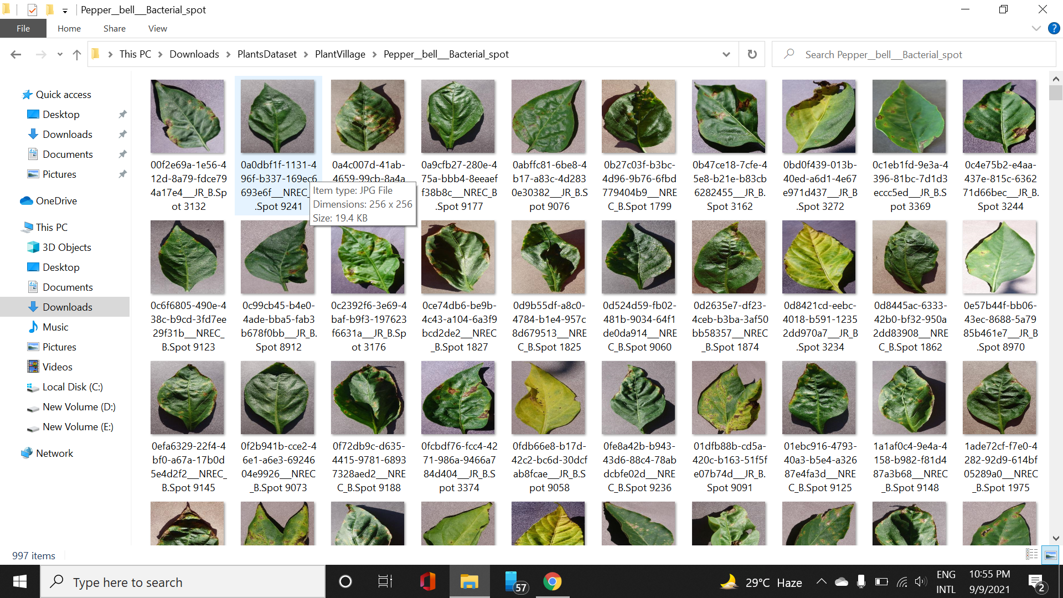
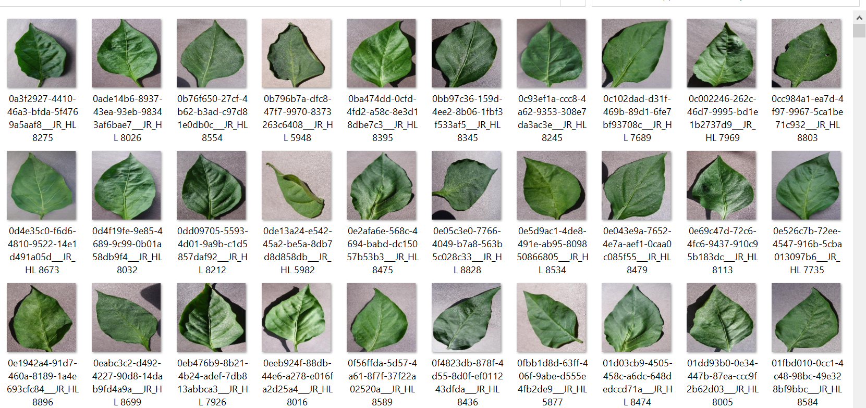
Leaf of Diseased Bell-Pepper Plant
Leaf of Healthy Bell-Pepper Plant

Slide 8
METHODOLOGY
yes
Input test Image
Preprocessing
Convert to an array for comparsion
Healthy
No
Defect
Segregated database
Preprocessing
Training model using CNN
CNN based classsification
Yes
Display disease name
Flowchart for disease detection

Slide 9
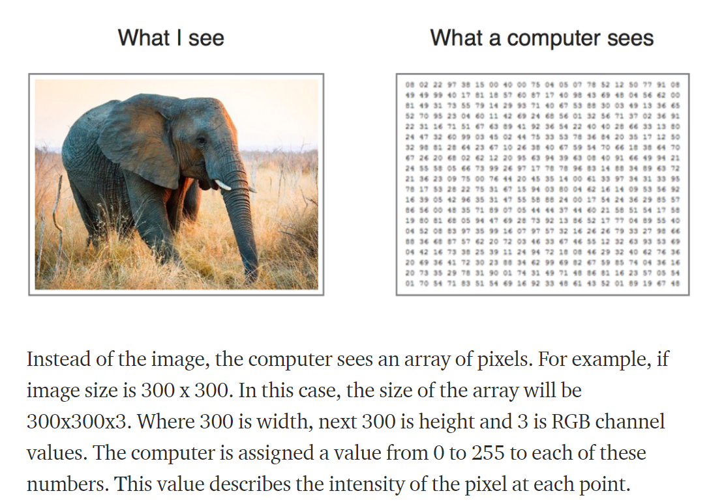
Image classification

Slide 10
tensorFlow imports:
Convo2D
MaxPooling2D
BatchNormalization
Activation
Flatten
Dense
Dropout

Slide 11
CONVO2D : Keras Conv2D is a 2D Convolution Layer, this layer creates a convolution kernel that is wind with layers input which helps produce a tensor of outputs. Mandatory Conv2D parameter is the numbers of filters that convolutional layers will learn from.It creates kernel which helps to produce tensor of outputs.
Convolutions have been used for a long time in image processing to blur and sharpen images, and perform other operations, such as, enhance edges
MAXPOOLING2D : When using the 2D Global Max Pooling block, all of the input channels are combined into one large pool and a single maximum value is computed for each channel. Pooling is the process of merging. So it’s basically for the purpose of reducing the size of the data. In Max pooling we choose the maximum value within a matrix. The size of the matrix could be 2 X 2 or 3 X 3 also.

Slide 12
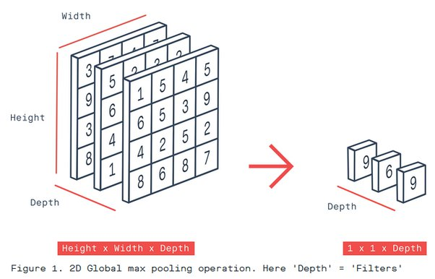

Slide 13
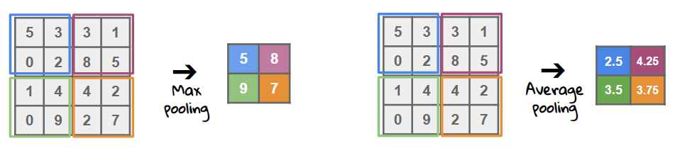

Slide 14
BATCHNORMALIZATION : Layer that normalizes its inputs. Batch normalization is a technique to standardize the inputs to a network, applied to ether the activations of a prior layer or inputs directly. Batch normalization accelerates training, in some cases by halving the epochs or better, and provides some regularization, reducing generalization error.
The goal of normalization is to transform features to be on a similar scale. This improves the performance and training stability of the model.
Activation : Activations can either be used through an Activation layer, or through the activation argument. It’s just a thing function that you use to get the output of node. It is also known as Transfer Function.It makes prediction of images . The Activation Functions can be basically divided into 2 types-
Linear Activation Function : It doesn’t help with the complexity or various parameters of usual data that is fed to the neural networks.
Non-linear Activation Functions : The Nonlinear Activation Functions are the most used activation functions. It makes it easy for the model to generalize or adapt with variety of data and to differentiate between the output.

Slide 15
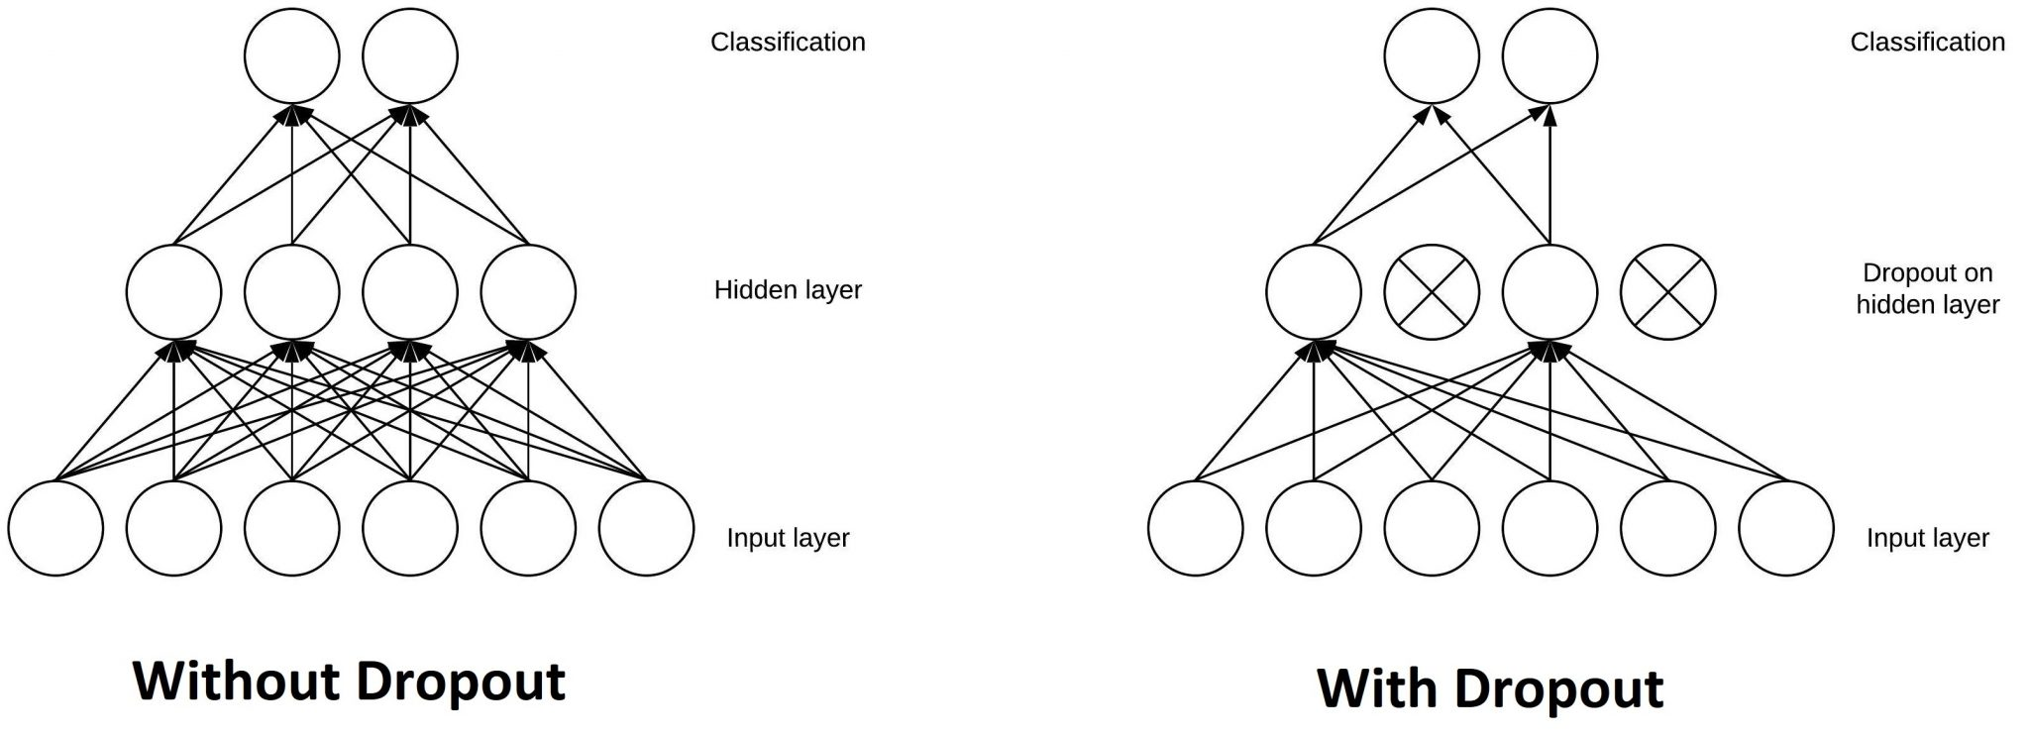
Flattening : Flattening is converting the data into a 1-dimensional array for inputting it to the next layer. We flatten the output of the convolutional layers to create a single long feature vector. And it is connected to the final classification model, which is called a fully-connected layer.
Dropout : The Dropout layer is a mask that nullifies the contribution of some neurons towards the next layer and leaves unmodified all others. Dropout layers are important in training CNNs because they prevent overfitting on the training data. If they aren’t present, the first batch of training samples influences the learning in a disproportionately high manner.

Slide 16
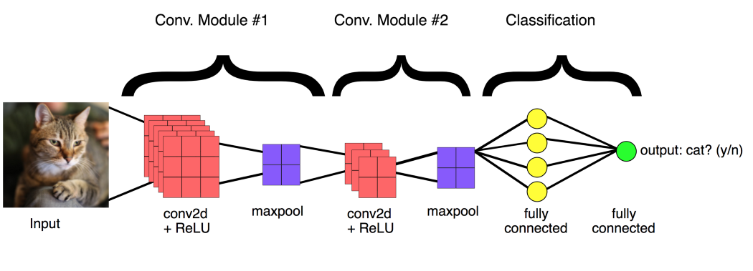

Slide 17
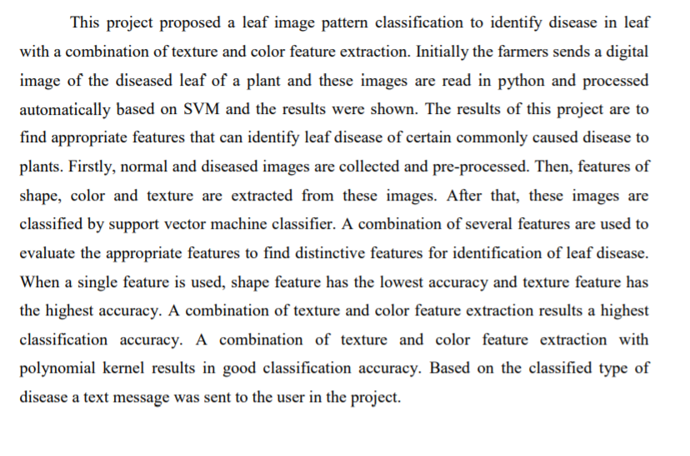
Conclusion and future scope

Slide 18
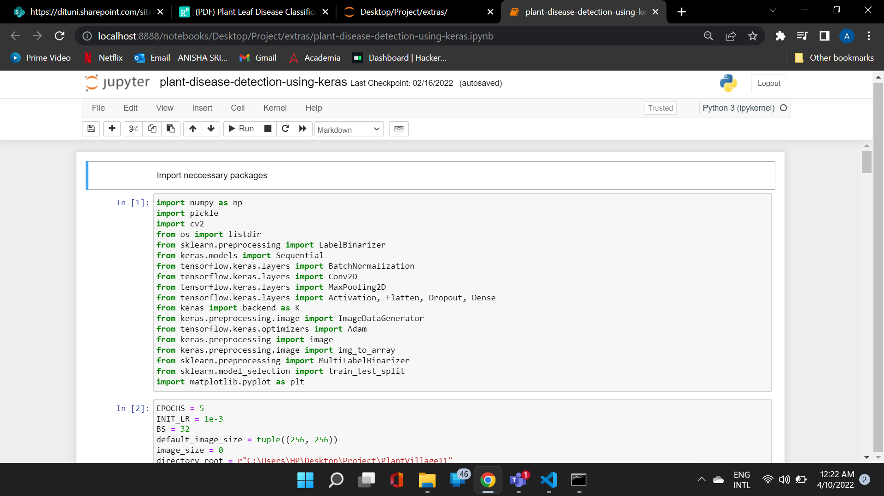
Screenshots

Slide 19
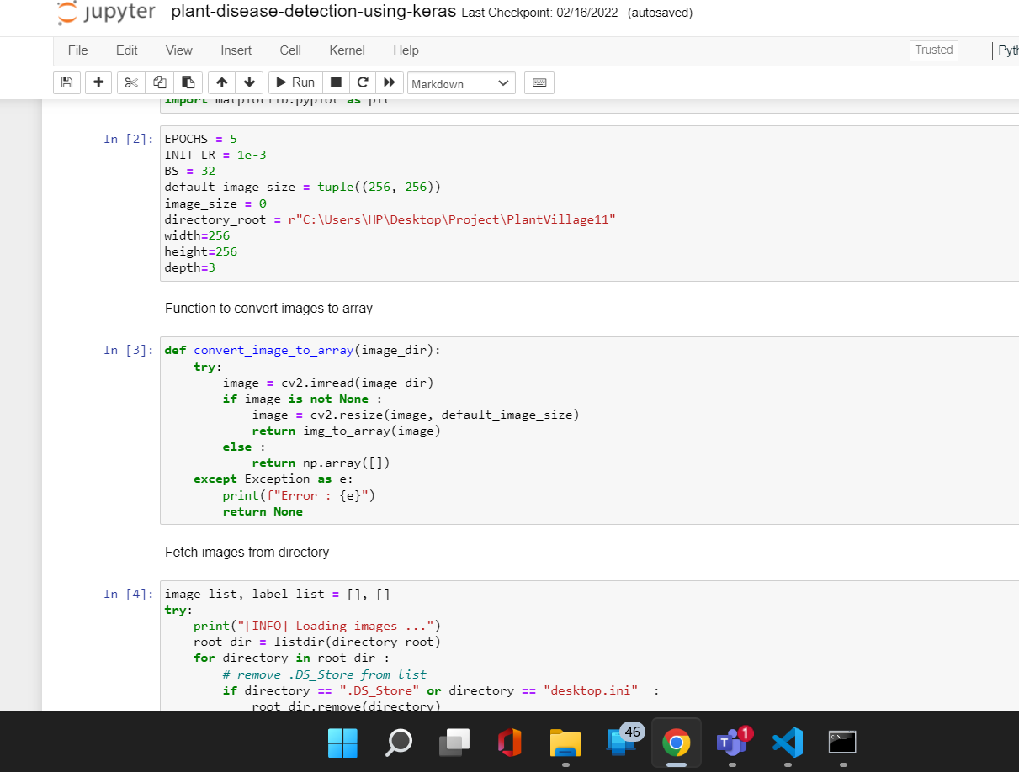

Slide 20
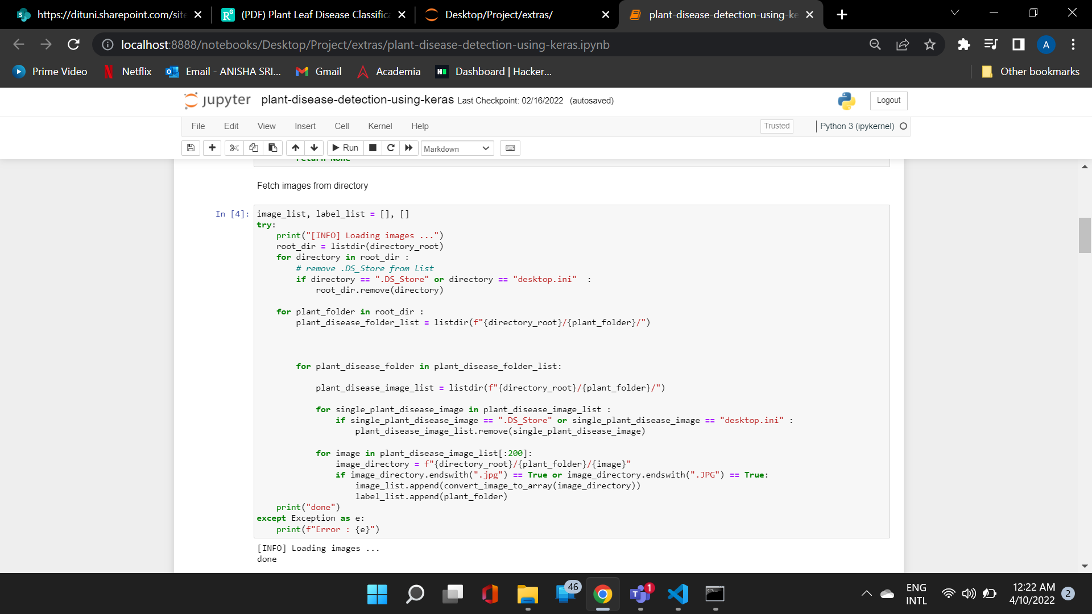
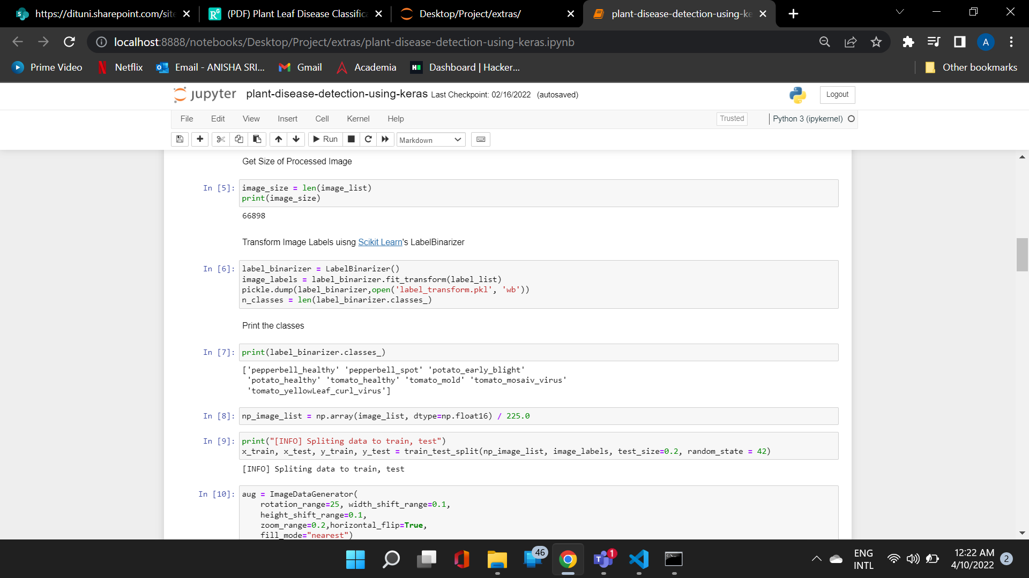

Slide 21
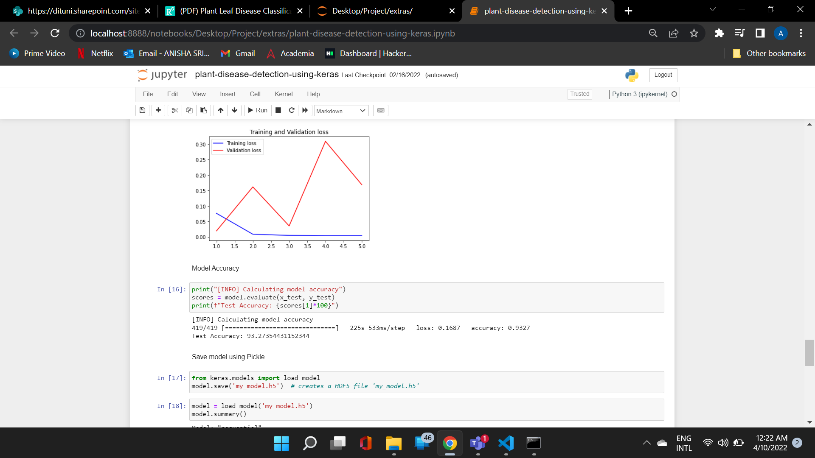
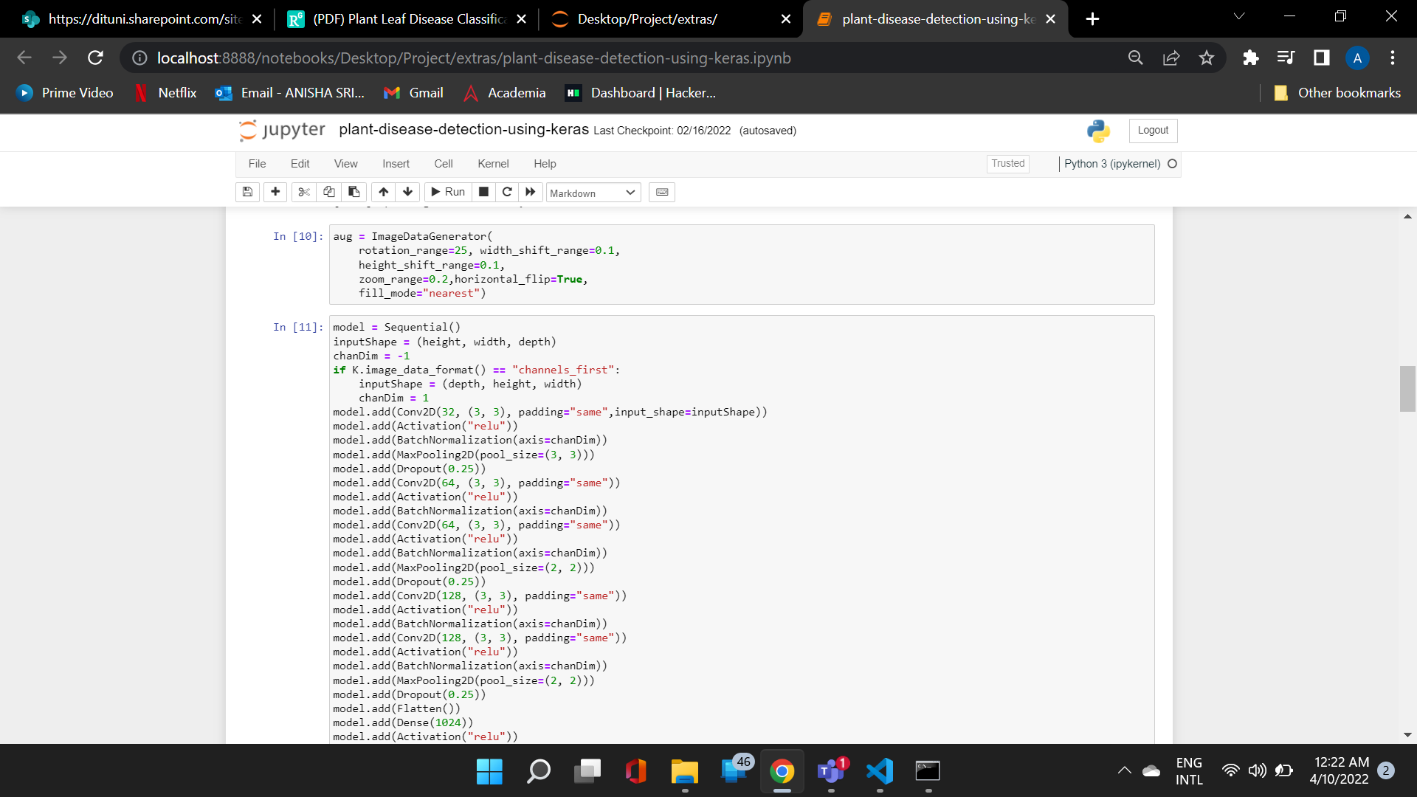

Slide 22
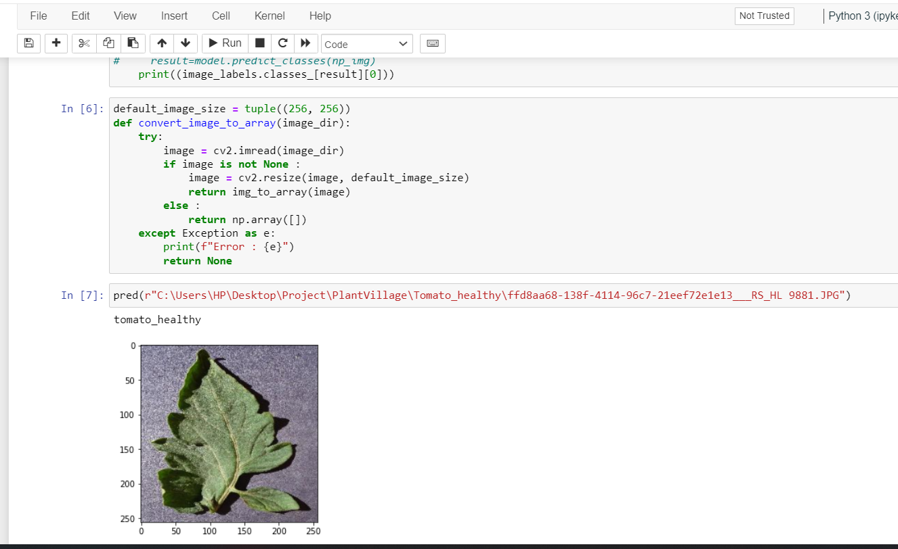

Slide 23
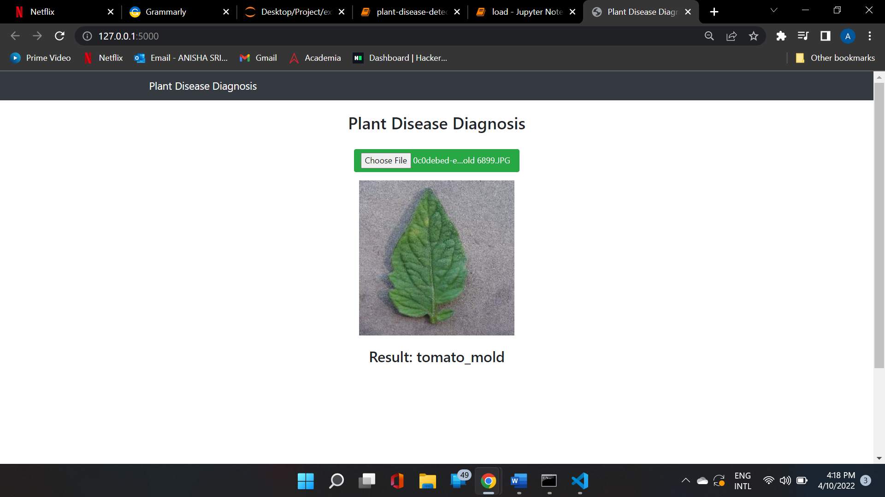
Implementation

Slide 24


